Slide 1

Team Athena
Patrick Mc Donnell- Teamlead/UI/Testing
Emma Loughran- Database/Backend
Cormac Levins- UI/Backend
Dónal McNally- Security/testing
Universal Design Project
CO3a
17/10/2018

Slide 2
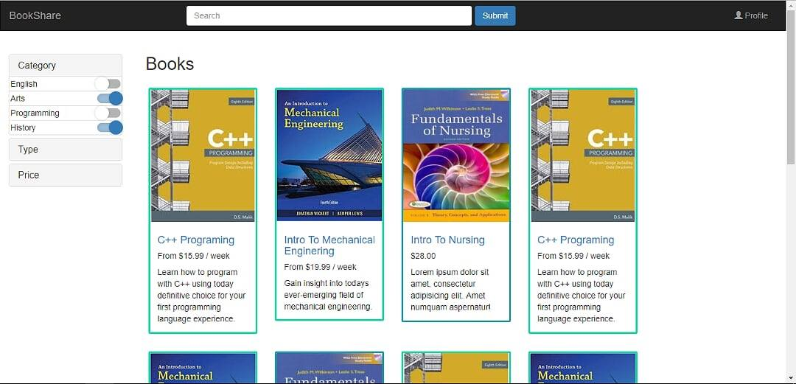
Home Page

Slide 3
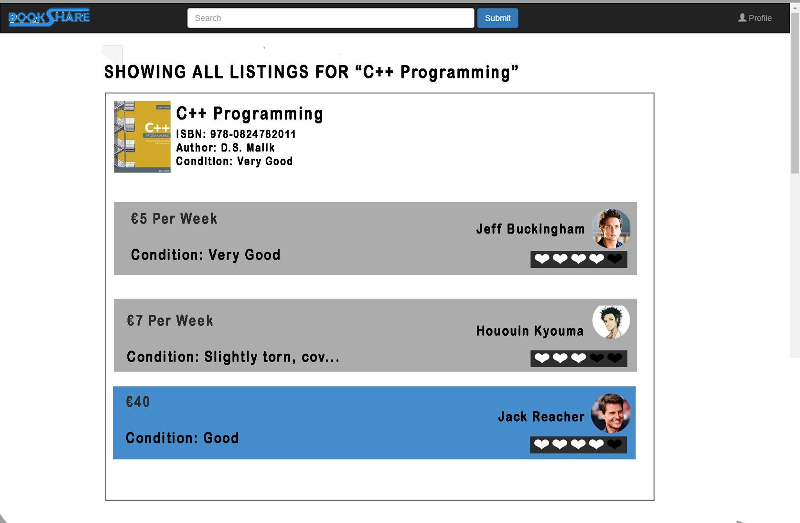
Search

Slide 4
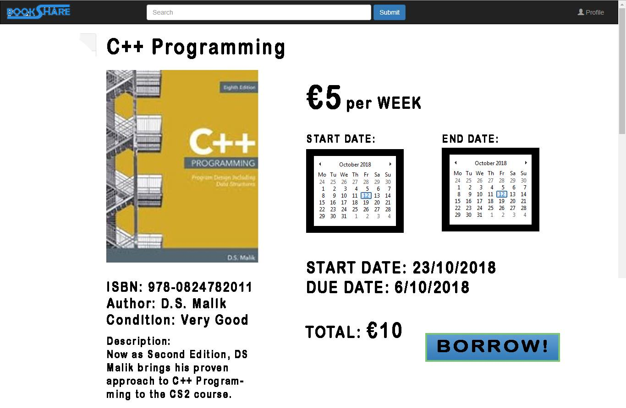
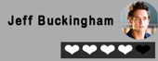

Book Page
Dundalk

Slide 5
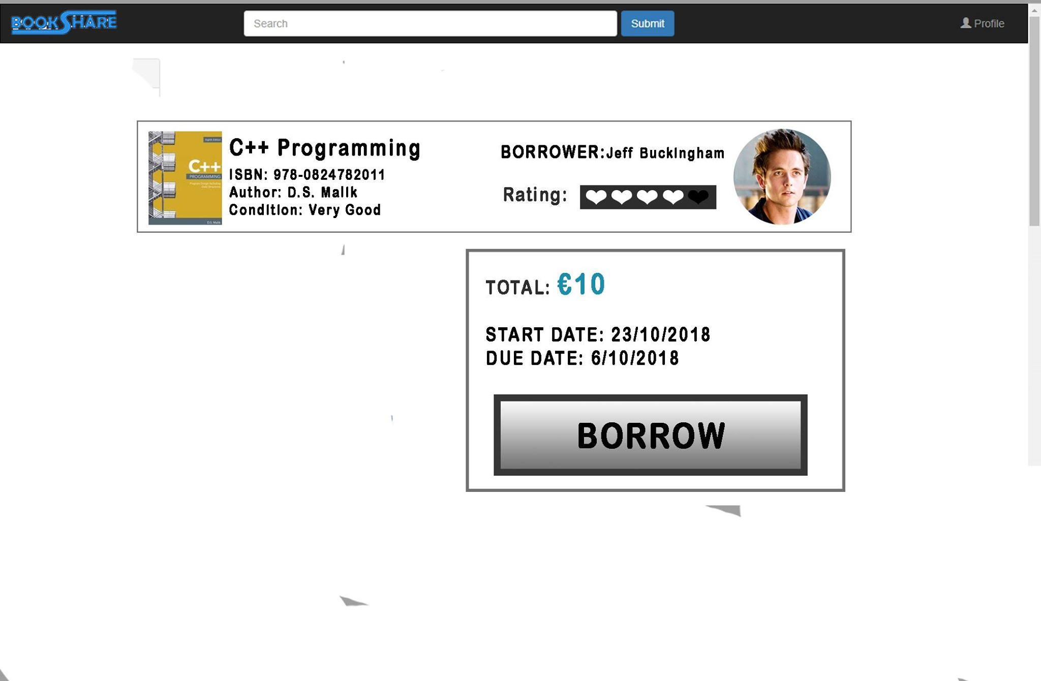
Payment Confirmation

Slide 6
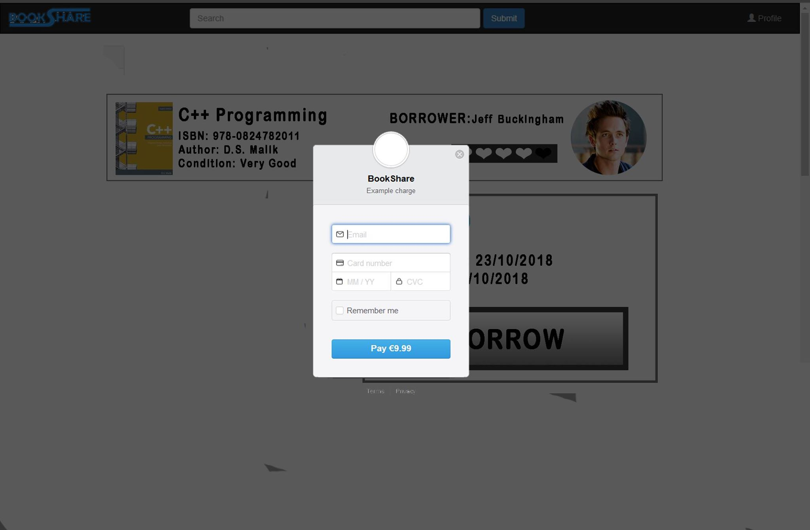
Payment- Stripe

Slide 7
Payment- Complete
Payment received! An email has been sent confirming payment with receipt to
mBurns12@Hotmail.com

Slide 8
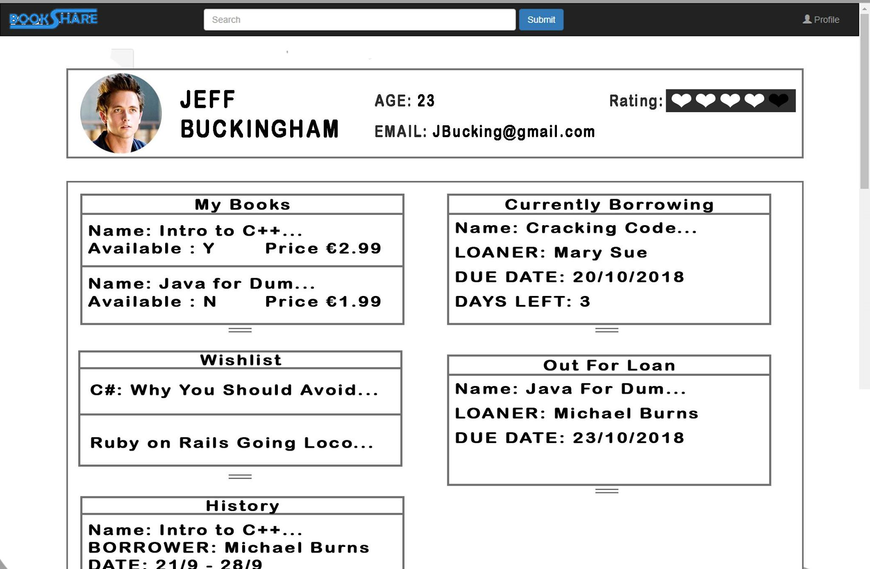
Profile

Slide 9
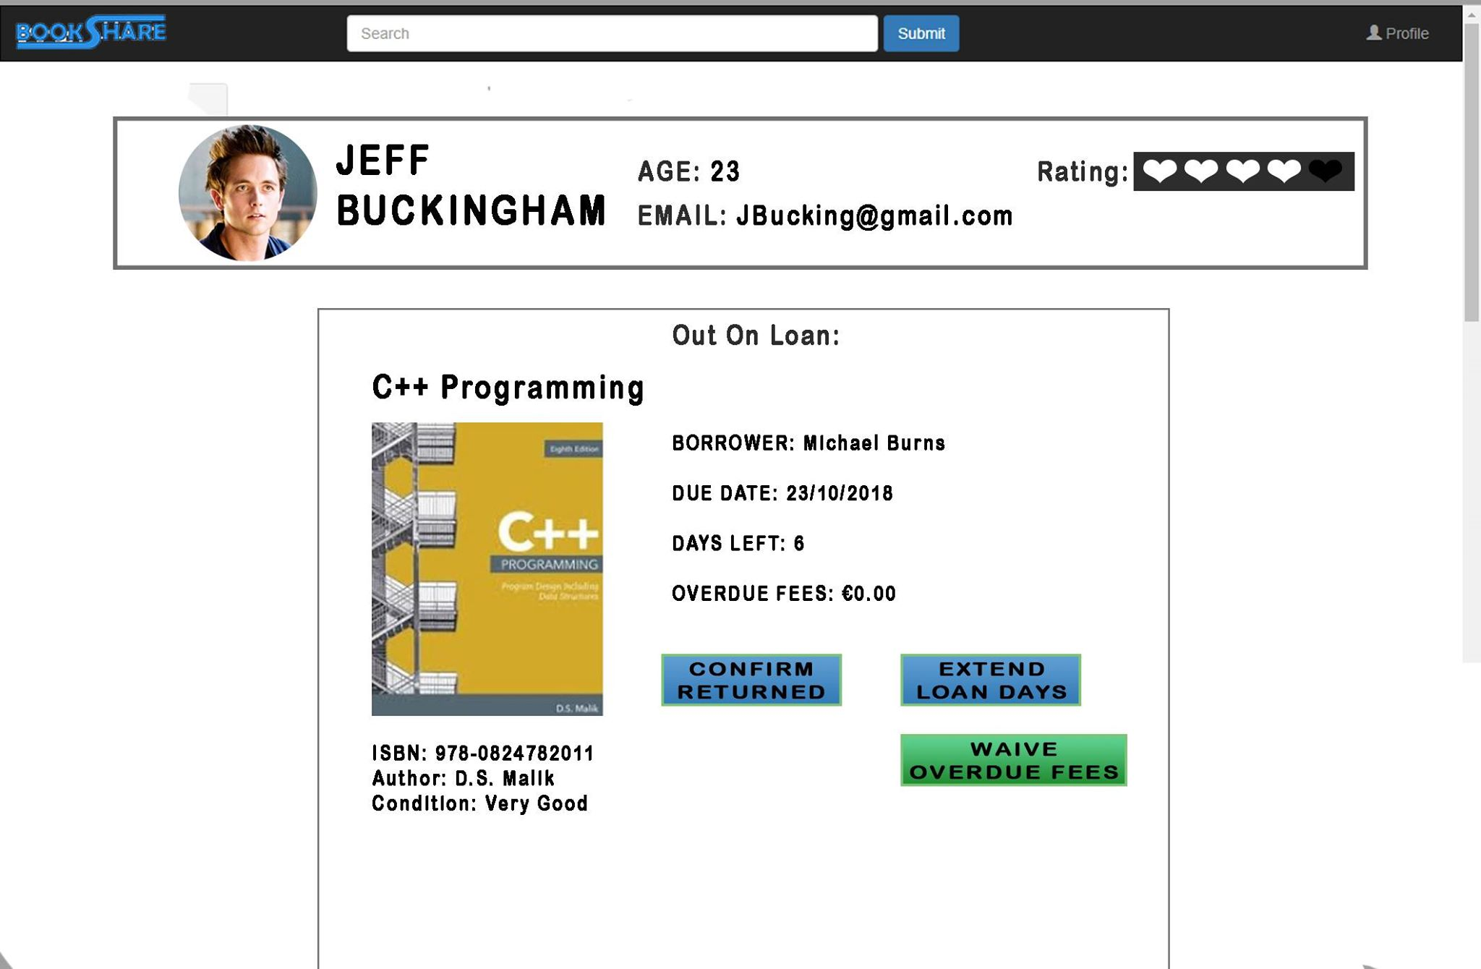
Profile - Out on loan info

Slide 10
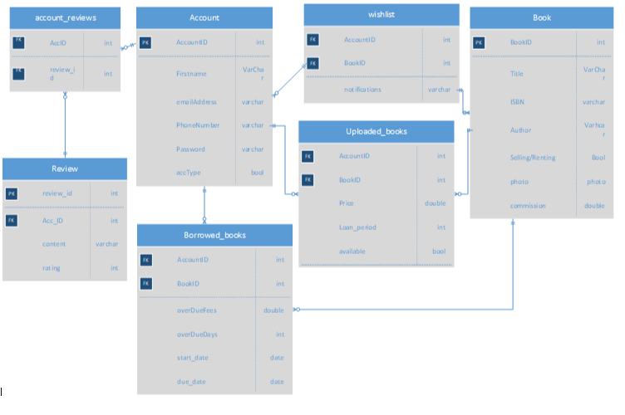
Database Schema

